Slide 1


2014-2020
Creative Europe
Culture
Info Flash
9. Dezember 2013
Mag. Elisabeth Pacher
Notes:
Welcome to Creative Europe
Let’s take a look at the Creative Europe programme, and what benefits and opportunities it offers to the cultural and creative sectors.

Slide 2


ÜBER CREATIVE EUROPE
7 Jahre (2014-2020)
Förderungen für:
Grenzüberschreitende Zusammenarbeit
Professionalisierung von Kultur- und Kreativschaffenden
Literarische Übersetzungen
Entwicklung europäischer Filme für Kino und Fernsehen, Videospiele
Verleih und Promotion europäischer Filme, Festivals, Kinonetzwerke
Transnationale politische Zusammenarbeit
2014-2020
Notes:
Distribution
These days, audiovisual professionals need to operate in both physical and online market-places.
To meet these demands, the MEDIA sub-programme offers support for international professional trade events, markets and other initiatives that can boost the circulation and distribution of European works inside and outside Europe, and international works in Europe.
However, it can be difficult to overcome the limitations the audiovisual industry faces in terms of film distribution outside domestic markets.
Financial help is available for European sales agents, theatrical distributors or exhibitors of European films to encourage and support the wider transnational distribution of recent European films in cinemas and on other platforms.

Slide 3
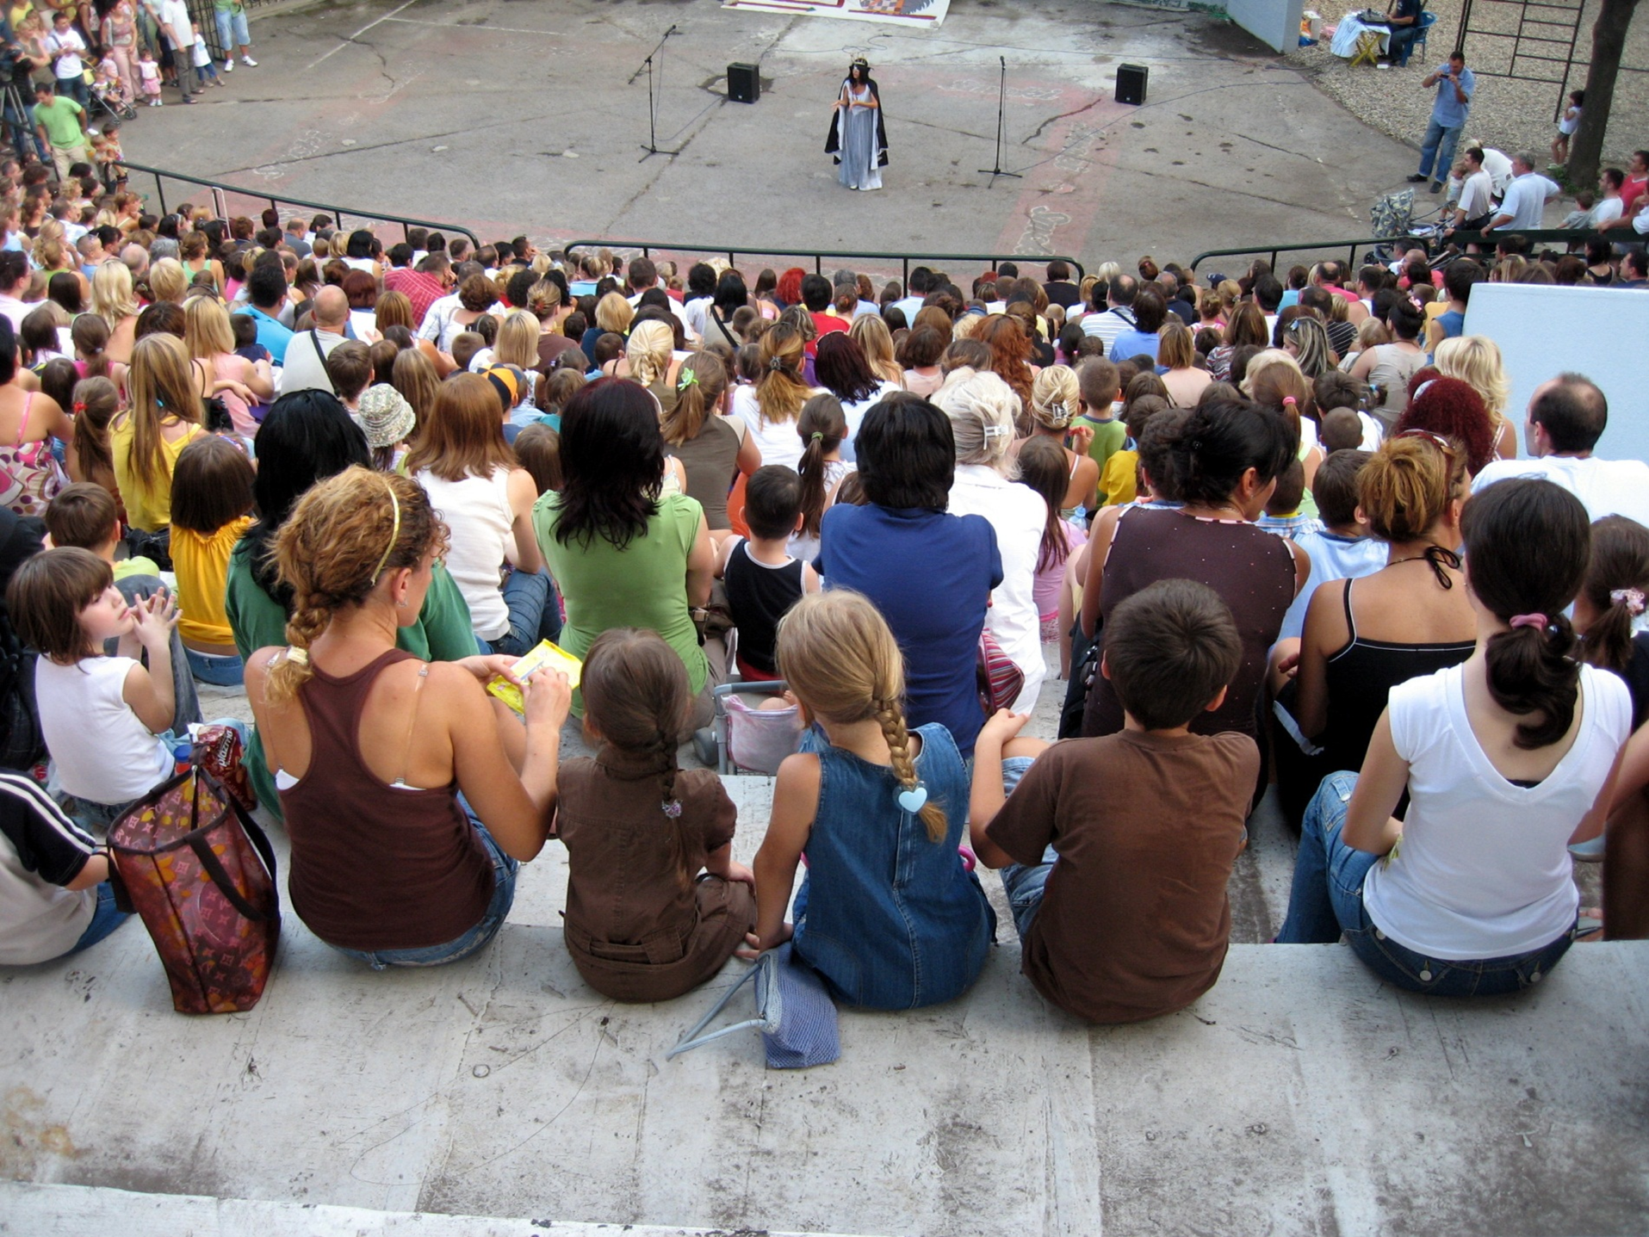
Notes:
Budget Breakdown
In terms of budget, the European Commission have shown their commitment to Creative Europe by proposing a massive €1.46 billion, which is a 9% increase on the previous programmes.
The funding is approximately distributed as shown, with 56% reserved for the MEDIA sub-programme, 31% for the Culture sub-programme and 13% for the Cross-sectoral strand
://ec.europa.eu/culture/media/creative-europe/index_en.htm

Slide 4

2014-2020
KULTUR
SUBPROGRAMM
Unterstützung von Künstlern und Kulturschaffenden in Europa
Notes:
Culture sub-programme
Creative Europe’s Culture sub-programme is intended to help cultural and creative organisations to operate across borders both within Europe and internationally.
The programme provides opportunities for the exchange of artists and performers between countries, allowing them to reach out to new and larger audiences in the EU and beyond.
Another focus is on supporting cultural and creative individuals and groups to enhance their skills and abilities by engaging in international cooperation activities and building strong international networks.
To sum up, the main priorities are cross-border cultural activities, the wider circulation of European literature, and stimulating interest in, and improving access to, European cultural and creative works and cultural heritage.
Now let’s take a closer look at the main areas in the Culture sub-programme.

Slide 5

2014-2020
FÖRDERSCHIENEN
Europ. Kooperationsprojekte
Europ. Netzwerke
Europ. Plattformen
Literarische Übersetzungen
Special Actions
Neu: Zielgerichtete Wirkung und klare Prioritäten
Neu: Publikumsentwicklung als transversale Prioriät
Notes:
Transnational Cooperation
Under the Culture sub-programme, there are opportunities to lead or take part in a variety of transnational cooperation projects that involve cultural and creative organisations
These organisations must be from at least three countries taking part in the programme and the kinds of activities that are supported include:
The exchange of cultural workers, allowing them to gain the skills they need to meet the challenges of a changing environment.
Extended stays and residencies in other EU countries for artists and cultural professionals, allowing them to develop their careers internationally.
Co-productions and performances between cultural organisations from different countries, such as concert halls, theatres and orchestras, which extend the lifespan of a production and help it to reach new audiences.
Cross-border lending and borrowing of artworks, bringing them to citizens across Europe.

Slide 6

2014-2020
HERAUSFORDERUNGEN
Fragmentierter Markt/ Kulturraum
Veränderungen durch Digitalisierung
Zugang zu Finanzierung
Mangel an Daten
Foto: © bankleer, Land of Human Rights/ rotor
Notes:
Transnational Cooperation
Under the Culture sub-programme, there are opportunities to lead or take part in a variety of transnational cooperation projects that involve cultural and creative organisations
These organisations must be from at least three countries taking part in the programme and the kinds of activities that are supported include:
The exchange of cultural workers, allowing them to gain the skills they need to meet the challenges of a changing environment.
Extended stays and residencies in other EU countries for artists and cultural professionals, allowing them to develop their careers internationally.
Co-productions and performances between cultural organisations from different countries, such as concert halls, theatres and orchestras, which extend the lifespan of a production and help it to reach new audiences.
Cross-border lending and borrowing of artworks, bringing them to citizens across Europe.

Slide 7

2014-2020
FORMALKRITERIEN
Förderfähige Länder:
EU Mitglieder, Beitrittsländer, (pot. Beitrittsländer, EFTA/EEA Länder, Schweiz
Länder der Europäischen Nachbarschaftspolitik
Förderbarer Antragsteller:
- tätig in einem Kultur- oder Kreativbereich
jur. Personen
Fokus „not for profit“ Projekte
Foto: ©Wolfgang Kirchner
Notes:
Literary Translation
In this area, the Culture sub-programme supports the translation and promotion of collections of fiction – known as packages – from one language to another.
All types of fiction can be translated, from a source into a target language both being official languages in countries taking part in the programme
The scheme also funds the promotion and distribution of these translated works through both traditional and digital channels, so they can reach new audiences.

Slide 8

2014-2020
KOOPERATIONS -
PROJEKTE
Ziele
Capacity Building für den Kultursektor
Transnationale Zirkulation und Mobilität
Notes:
Networks and Platforms
Other areas that the Culture sub-programme offers funding for are networks and platforms.
•Networks enable cultural players to cooperate internationally and to internationalise their careers and activities
•Networks focus on supporting actions providing cultural players with skills, competences and know-how that contribute to strengthening the cultural and creative sectors, including encouraging adaptation to digital technologies, testing of new business and management models and testing new approaches to audience development
•Platforms seeking to foster the development of emerging talent and to stimulate the transnational mobility of cultural and creative players and circulation and diffusion of works
•Under the Culture sub-programme, funding is available to platforms fostering the mobility and the visibility of European creators and artists, stimulating a genuine Europe-wide programming of cultural and artistic activities and contributing to greater audience development

Slide 9
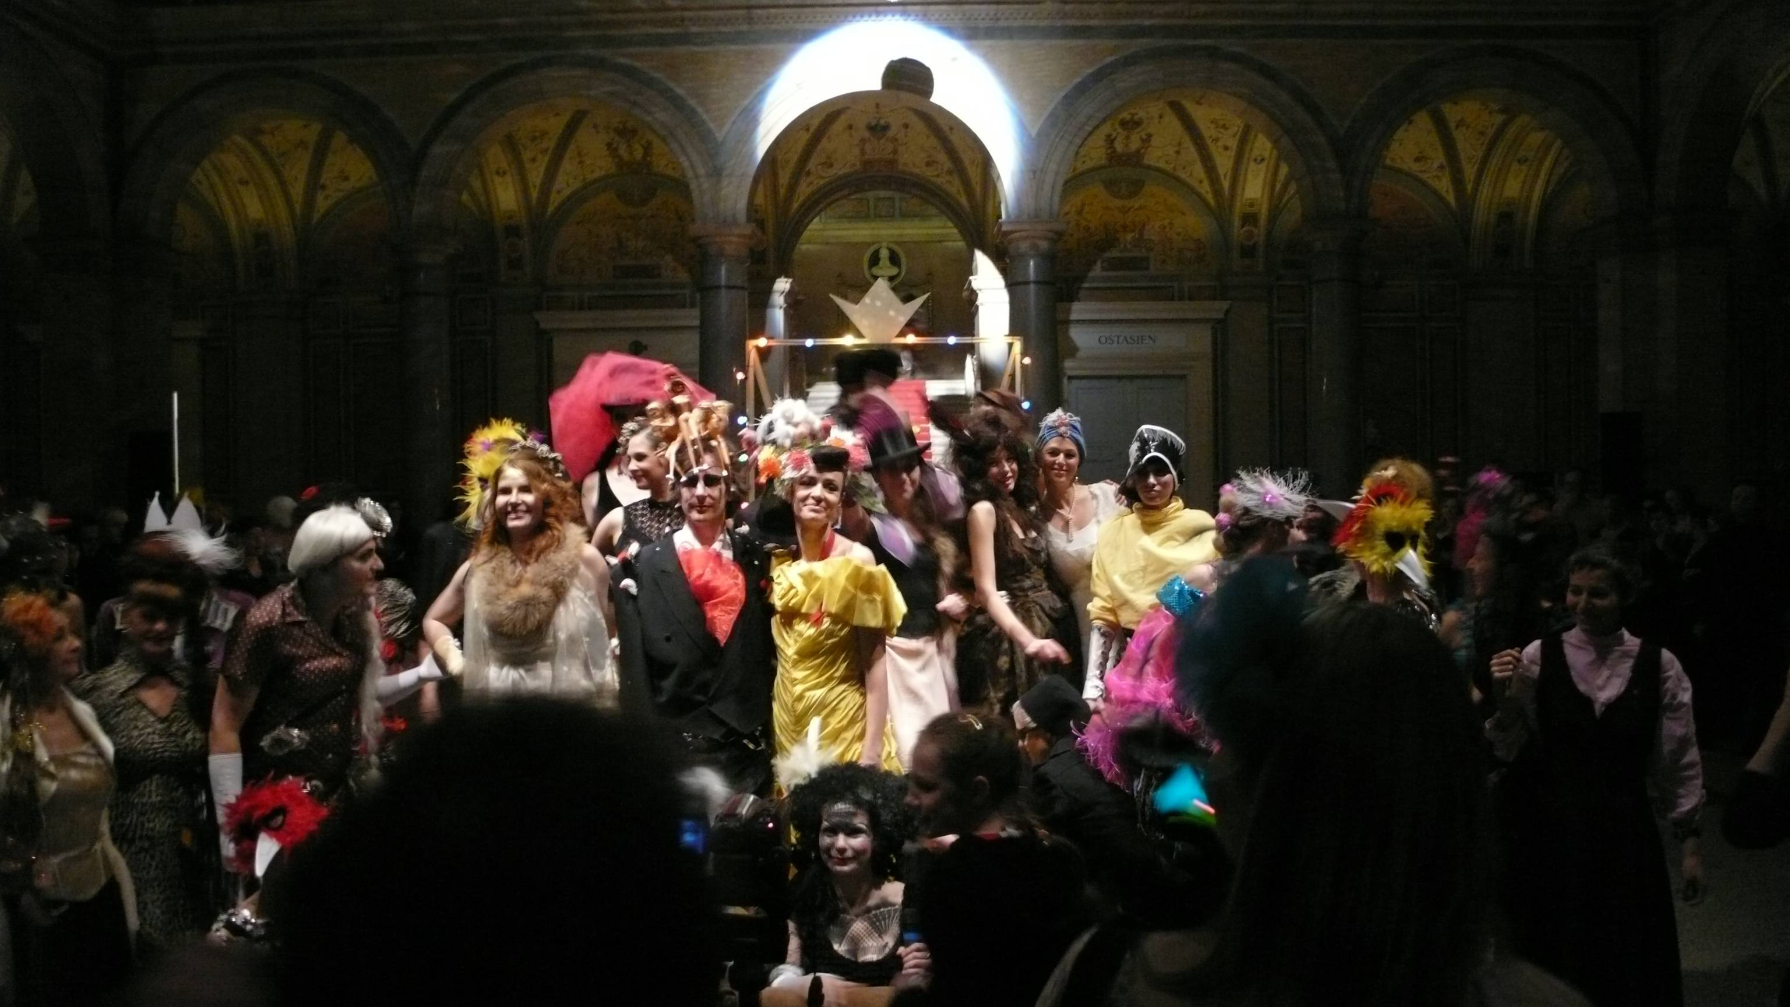
2014-2020
Prioritäten
Capacity Building:
Erwerb von Fertigkeiten, Kompetenzen und Know-how einschl. Nutzung digitaler Technologien, neuer Business- u. Managementmodelle
Zirkulation:
int. Zusammenarbeit und Karrieren
int. Vernetzung und berufliche Möglichkeiten
int. kulturelle Aktivitäten
Austausch von (literar.) Werken
& Audience Development
Foto: © MAK/ Andreas Kristof, MAK NITE
Notes:
Literary Translation
In this area, the Culture sub-programme supports the translation and promotion of collections of fiction – known as packages – from one language to another.
All types of fiction can be translated, from a source into a target language both being official languages in countries taking part in the programme
The scheme also funds the promotion and distribution of these translated works through both traditional and digital channels, so they can reach new audiences.

Slide 10
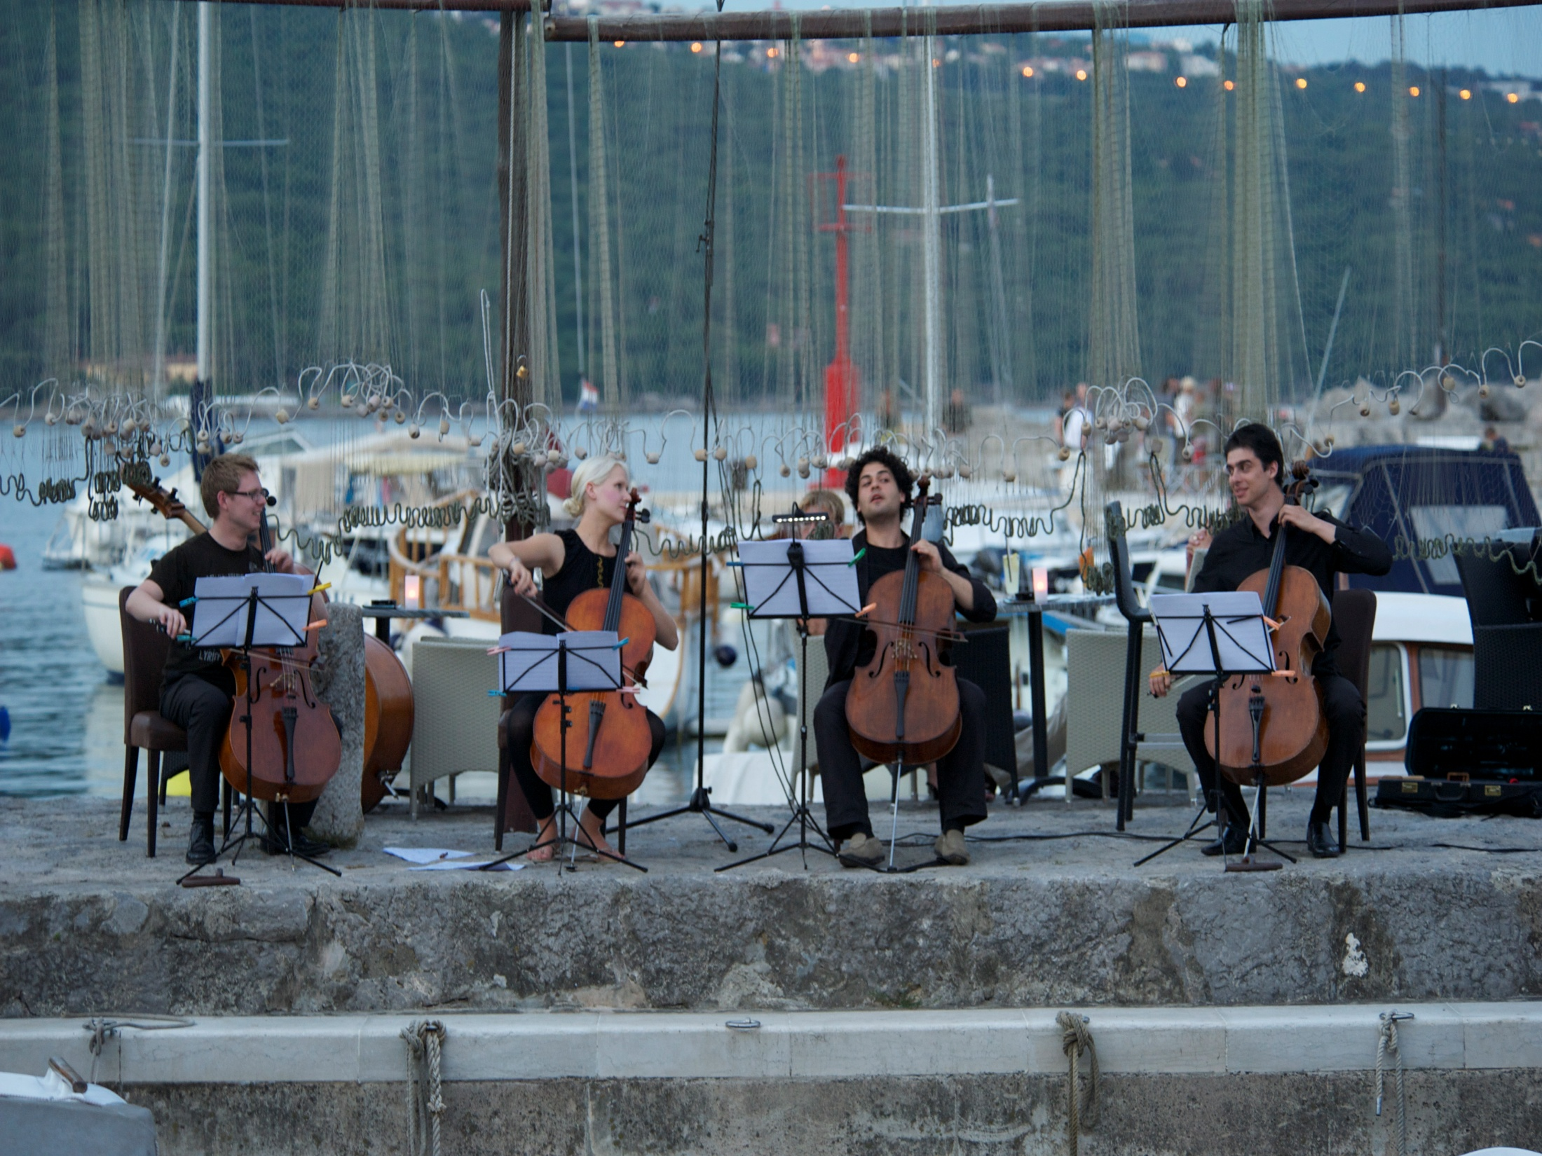
2014-2020
Form
Kategorie 1: „kleine Projekte“
1 Koordinator + 2 Mitorganisatoren
EU-Zuschuss: max € 200.000,
max. 60% der förderbaren Kosten
Kategorie 2: „große Projekte“
1 Koordinator + 5 Mitorganisatoren
EU-Zuschuss: max. € 2 Mio,
max. 50% der förderbaren Kosten
Foto: © ad libitum Konzertwerkstatt gGmbH,
Notes:
Literary Translation
In this area, the Culture sub-programme supports the translation and promotion of collections of fiction – known as packages – from one language to another.
All types of fiction can be translated, from a source into a target language both being official languages in countries taking part in the programme
The scheme also funds the promotion and distribution of these translated works through both traditional and digital channels, so they can reach new audiences.

Slide 11

2014-2020
Förderfähigeitskriterien
Max. 4 Jahre Laufzeit
keine Untergrenzen
Mitorganisatoren aus teilnehmenden Ländern
2014:
+/ - 100 geförderte Projekte
€ 38 Mio
Logo: ©Igor Manasteriotti und Mia Maric/ Phonart
Notes:
Literary Translation
In this area, the Culture sub-programme supports the translation and promotion of collections of fiction – known as packages – from one language to another.
All types of fiction can be translated, from a source into a target language both being official languages in countries taking part in the programme
The scheme also funds the promotion and distribution of these translated works through both traditional and digital channels, so they can reach new audiences.

Slide 12

2014-2020
Auswahlkriterien
Relevanz (35)
Qualität von Inhalt und Aktivitäten (25)
Kommunikation und Dissemination (20)
Qualität der Partnerschaft (20)
Foto: © Werner Kmetisch, Styriarte
Notes:
Literary Translation
In this area, the Culture sub-programme supports the translation and promotion of collections of fiction – known as packages – from one language to another.
All types of fiction can be translated, from a source into a target language both being official languages in countries taking part in the programme
The scheme also funds the promotion and distribution of these translated works through both traditional and digital channels, so they can reach new audiences.

Slide 13
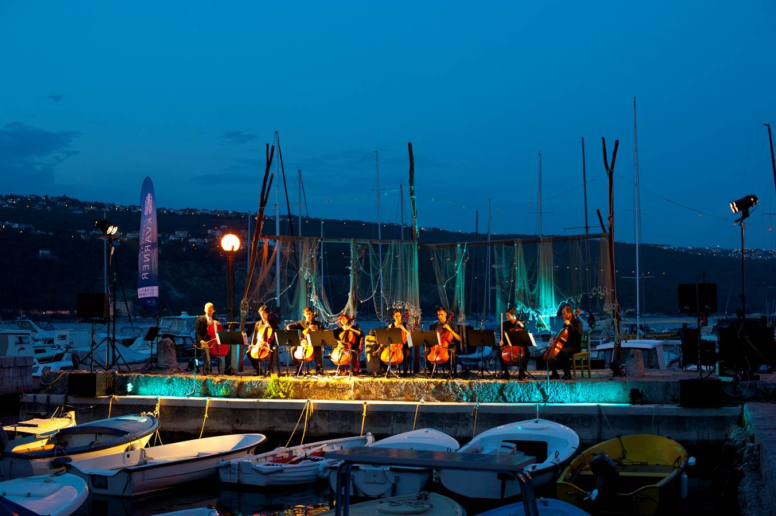
2014-2020
Beispiele
Trainings, Workshops, Vorbereitung von Materialien, Websites
Aufenthalte und Residenzen (gemeinsames) künstlerisches Schaffen
Austausch und Koproduktionen kultureller Organisationen, Audience Development, Zugang zu Werken, Entwicklung neuer beruflicher Möglichkeiten
Qualität von Inhalt und Aktivitäten
Austausch, internationaler Verleih von Werken
Foto: © ad libitum Konzertwerkstatt gGmbH
Notes:
Literary Translation
In this area, the Culture sub-programme supports the translation and promotion of collections of fiction – known as packages – from one language to another.
All types of fiction can be translated, from a source into a target language both being official languages in countries taking part in the programme
The scheme also funds the promotion and distribution of these translated works through both traditional and digital channels, so they can reach new audiences.

Slide 14

2014-2020
EUROPÄISCHE NETZWERKE
Von Interessensvertretung zu Professionalisierung
Synergien & strukturierender Effekt
Ziele
Verstärkte transnationale Zusammenarbeit der Kultur- und Kreativsektoren
Förderung der kulturellen und sprachlichen Vielfalt und der Wettbewerbsfähigkeit
„business to business“
Foto: © ruba Earth, Finnbogi Petursson, ars electronica
Notes:
Literary Translation
In this area, the Culture sub-programme supports the translation and promotion of collections of fiction – known as packages – from one language to another.
All types of fiction can be translated, from a source into a target language both being official languages in countries taking part in the programme
The scheme also funds the promotion and distribution of these translated works through both traditional and digital channels, so they can reach new audiences.

Slide 15
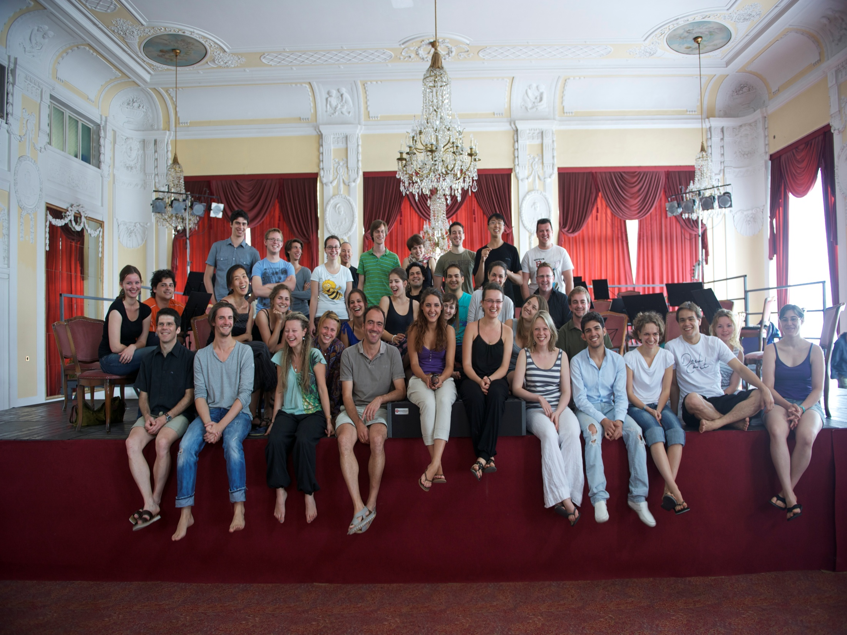
2014-2020
Prioritäten
Capacity Building:
Fertigkeiten, Kompetenzen und Know-how für Kulturschaffende ( digitale Technologien, neue Business- und Management-modelle)
Internationalisierung der Zusammenarbeit, von Karrieren und Aktivitäten
Zugang zu beruflichen Möglichkeiten durch internat. Vernetzung
& Audience Development
Foto: © ad libitum Konzertwerkstatt gGmbH
Notes:
Literary Translation
In this area, the Culture sub-programme supports the translation and promotion of collections of fiction – known as packages – from one language to another.
All types of fiction can be translated, from a source into a target language both being official languages in countries taking part in the programme
The scheme also funds the promotion and distribution of these translated works through both traditional and digital channels, so they can reach new audiences.

Slide 16
2014-2020
Form
Netzwerke: sind aktiv in den Kultur- und Kreativsektoren, mind. 15 Mitglieder aus mind. 10 Ländern
Projektförderungen:
max. € 250.000, max. 80%
Nur 2 Calls: 2013 und 2016
2014:
+/- 25 Netzwerke/ Jahr
€ 3,4 Mio
Foto: © MAK/ Andreas Kristof, MAK NITE
Notes:
Literary Translation
In this area, the Culture sub-programme supports the translation and promotion of collections of fiction – known as packages – from one language to another.
All types of fiction can be translated, from a source into a target language both being official languages in countries taking part in the programme
The scheme also funds the promotion and distribution of these translated works through both traditional and digital channels, so they can reach new audiences.

Slide 17
2014-2020
Netzwerkaktivitäten
Meetings, Konferenzen, digitale Tools zur Förderung des Informationsaustauschs und des Peer Learnings für Internationalisierung und Professionalisierung
Unterstützung des multilateralen Austausches, der professionellen Vernetzung, Projektpartner- und Projektentwicklung
Analyse und Vergleich von Politiken und Programmen
Analyse und Sammlung von Daten (qualitativ, quantitativ)
Newsletter und Datenbanken
Logo: ©Igor Manasteriotti und Mia Maric/ Phonart
Notes:
Literary Translation
In this area, the Culture sub-programme supports the translation and promotion of collections of fiction – known as packages – from one language to another.
All types of fiction can be translated, from a source into a target language both being official languages in countries taking part in the programme
The scheme also funds the promotion and distribution of these translated works through both traditional and digital channels, so they can reach new audiences.

Slide 18
2014-2020
Vergabekriterien
Relevanz (30)
Qualität und Inhalt der Aktivitäten (25)
Kommunikation und Dissemination (15)
Qualität des Europäischen Netzwerks (30)
Foto: © ad libitum Konzertwerkstatt gGmbH
Notes:
Literary Translation
In this area, the Culture sub-programme supports the translation and promotion of collections of fiction – known as packages – from one language to another.
All types of fiction can be translated, from a source into a target language both being official languages in countries taking part in the programme
The scheme also funds the promotion and distribution of these translated works through both traditional and digital channels, so they can reach new audiences.

Slide 19
2014-2020
EUROPÄISCHE PLATTFORMEN
Ziele
Entwicklung von Nachwuchskünstlern („emerging talent“) durch Förderung der transnationalen Mobilität von Kulturschaffenden und Werken
Anerkennung und Visibilität europ. Kultur- und Kreativakteure
Europäische Programmierung
„business to consumers“
Notes:
Transnational Cooperation
Under the Culture sub-programme, there are opportunities to lead or take part in a variety of transnational cooperation projects that involve cultural and creative organisations
These organisations must be from at least three countries taking part in the programme and the kinds of activities that are supported include:
The exchange of cultural workers, allowing them to gain the skills they need to meet the challenges of a changing environment.
Extended stays and residencies in other EU countries for artists and cultural professionals, allowing them to develop their careers internationally.
Co-productions and performances between cultural organisations from different countries, such as concert halls, theatres and orchestras, which extend the lifespan of a production and help it to reach new audiences.
Cross-border lending and borrowing of artworks, bringing them to citizens across Europe.

Slide 20
2014-2020
Prioritäten & Beispiele
Mobilität und Visibilität von Künstlern und Kreativen
Europaweite Programmierung durch erleichterten Zugang zu Werken (int. Tourneen, Ausstellungen, Festivals …)
Kommunikations- & Branding Strategie, mögl. Europ. Qualitätslabels
Audience Development durch Nutzung der IT & innovativer Methoden
Visibilität für Europäische Werte und Kulturen, Bewußtseins-bildung für die EU
Foto: © ruba Earth, Finnbogi Petursson, ars electronica
Notes:
Literary Translation
In this area, the Culture sub-programme supports the translation and promotion of collections of fiction – known as packages – from one language to another.
All types of fiction can be translated, from a source into a target language both being official languages in countries taking part in the programme
The scheme also funds the promotion and distribution of these translated works through both traditional and digital channels, so they can reach new audiences.

Slide 21
2014-2020
Form
Unterstützung f. Organisationen aus dem Kultur- und Kreativbereich, die Europäische Künstler und Kreative präsentieren und fördern
Plattform:
Koordinator + 10 Mitglieder
aus 10 teiln. Ländern, davon mind. 5 aus EU/ EFTA
Koordinator:
organisiert Plattform und Aktivitäten
wählt Mitglieder aus
entwickelt Kommunikations-
& Branding Strategie, gem.
Aktivitäten
Foto: © MAK/ Andreas Kristof, MAK NITE
Notes:
Literary Translation
In this area, the Culture sub-programme supports the translation and promotion of collections of fiction – known as packages – from one language to another.
All types of fiction can be translated, from a source into a target language both being official languages in countries taking part in the programme
The scheme also funds the promotion and distribution of these translated works through both traditional and digital channels, so they can reach new audiences.

Slide 22
2014-2020
Form
Koordinator:
gibt den EU-Zuschuss an Mitglieder weiter
ist rechtlich und finanziell
verantwortlich
Mitglieder der Plattform:
präsentieren und fördern
Europ. Künstler und Kreative
Entsprechen Kriterienset
in letzten 12 Monaten mind. 30% „emerging artis“
im Programm
Foto: ©Wolfgang Kirchner
Notes:
Literary Translation
In this area, the Culture sub-programme supports the translation and promotion of collections of fiction – known as packages – from one language to another.
All types of fiction can be translated, from a source into a target language both being official languages in countries taking part in the programme
The scheme also funds the promotion and distribution of these translated works through both traditional and digital channels, so they can reach new audiences.

Slide 23
2014-2020
Form
EU-Zuschuss: max. € 500.000/ Jahr und max. 80%
€ 60.000/ Mitglied
3 Calls während Laufzeit
(2013, 2015, 2016)
2014:
+/- 10 Projekte
€ 3,4 Mio
Foto: © Werner Kmetisch, Styriarte
Notes:
Literary Translation
In this area, the Culture sub-programme supports the translation and promotion of collections of fiction – known as packages – from one language to another.
All types of fiction can be translated, from a source into a target language both being official languages in countries taking part in the programme
The scheme also funds the promotion and distribution of these translated works through both traditional and digital channels, so they can reach new audiences.

Slide 24
2014-2020
Vergabekriterien
Relevanz (25)
Qualität von Inhalt und Aktivitäten (20)
Promotion, Kommunikation, Branding (30)
Qualität der Plattform (25)
Notes:
Culture sub-programme
Creative Europe’s Culture sub-programme is intended to help cultural and creative organisations to operate across borders both within Europe and internationally.
The programme provides opportunities for the exchange of artists and performers between countries, allowing them to reach out to new and larger audiences in the EU and beyond.
Another focus is on supporting cultural and creative individuals and groups to enhance their skills and abilities by engaging in international cooperation activities and building strong international networks.
To sum up, the main priorities are cross-border cultural activities, the wider circulation of European literature, and stimulating interest in, and improving access to, European cultural and creative works and cultural heritage.
Now let’s take a closer look at the main areas in the Culture sub-programme.

Slide 25

2014-2020
LITERARISCHE ÜBERSETZUNGEN
Ziele
Förderung der kulturellen und sprachlichen Vielfalt
Förderung der transnationalen Zirkulation Europ. Literatur von hoher Qualität, Verbesserung des Zugangs zu lit. Werken, Erreichung neuer Publikumsschichten
Notes:
Literary Translation
In this area, the Culture sub-programme supports the translation and promotion of collections of fiction – known as packages – from one language to another.
All types of fiction can be translated, from a source into a target language both being official languages in countries taking part in the programme
The scheme also funds the promotion and distribution of these translated works through both traditional and digital channels, so they can reach new audiences.

Slide 26
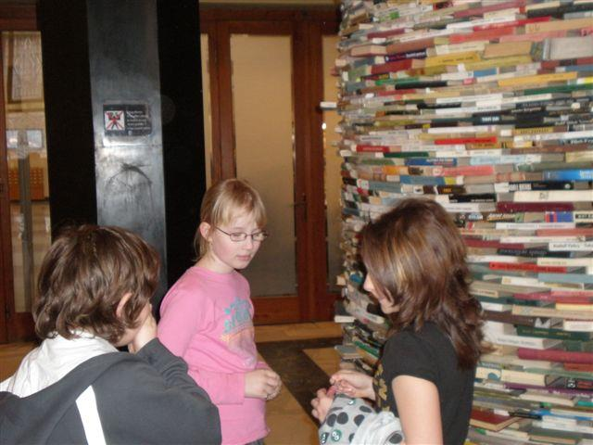
2014-2020
Neuheiten
PR-Kosten und eBooks sind förderbar
Stärkung der Rolle des Übersetzers durch Anfügung eines CVs
Mehrjähr. Abkommen („FPA`s“)
Automatische Punkte für Gewinner des Europ. Literaturpreises
Budgetbasierte Kalkulation
(keine Flatrates mehr)
Jährl. Calls
FPAs (3 – 4 Jahre)
2 Calls 2013, 2016
Notes:
Literary Translation
In this area, the Culture sub-programme supports the translation and promotion of collections of fiction – known as packages – from one language to another.
All types of fiction can be translated, from a source into a target language both being official languages in countries taking part in the programme
The scheme also funds the promotion and distribution of these translated works through both traditional and digital channels, so they can reach new audiences.

Slide 27
Form
2-Jahresprojekte:
3 – 10 Werke
Max. € 100.000, max. 50%
Mehrjahresprojekte („FPAs“):
5 – 10 Werke
Max: € 100.000/ Jahr, max. 50%
2014:
+/ - 60 Projekte
€ 3,6 Mio
2014-2020
Notes:
Literary Translation
In this area, the Culture sub-programme supports the translation and promotion of collections of fiction – known as packages – from one language to another.
All types of fiction can be translated, from a source into a target language both being official languages in countries taking part in the programme
The scheme also funds the promotion and distribution of these translated works through both traditional and digital channels, so they can reach new audiences.

Slide 28
2014-2020
Förderfähigeitskriterien
Übersetzungen in Sprachen der teiln. Länder, Latein und Griechisch
Ausgangs- oder Zielsprache ist offiz. Sprache eines EU/EFTA Landes
Zielsprache ist Muttersprache des/der ÜbersetzerIn (begründ. Ausnahmen)
Werke: Papier od. eBooks
Original veröffentlicht, nicht übersetzt (Neuübersetzung nach 50 J)
Autoren: Staatsbürg., Aufenthalt in förderbaren Ländern
Förderbare Aktivitäten
Übersetzung von Werken bzw. Ausschnitte
Veröffentlichung (Copyright, Druck, Lektorat, Design)
PR Events (Special Events, Marketing)
Keine Personalkosten, keine indir. Kosten
Logo: ©Igor Manasteriotti und Mia Maric/ Phonart
Notes:
Literary Translation
In this area, the Culture sub-programme supports the translation and promotion of collections of fiction – known as packages – from one language to another.
All types of fiction can be translated, from a source into a target language both being official languages in countries taking part in the programme
The scheme also funds the promotion and distribution of these translated works through both traditional and digital channels, so they can reach new audiences.

Slide 29

2014-2020
Audiovisuelle Aktivitäten
… sind förderbar:
wenn sie kulturelle Aktivitäten ergänzen
Akteure aus AV-Bereich können in Netzwerke und Plattformen
einbezogen werden.
Notes:
MEDIA sub-programme
The MEDIA strand of Creative Europe supports the EU’s film and audiovisual industries to develop, distribute and promote their work across all platforms.
It helps projects with a European dimension to get off the ground and find new international markets, and also part-funds the training and development of both budding filmmakers and established professionals.
Funding is targeted at a number of areas including: strengthening the industries’ levels of innovation and competitiveness, testing new approaches to audience development, helping to develop projects with a greater international appeal, and encouraging more European and international co-productions.
Finally, the programme aims to increase the distribution of audiovisual projects through international marketing, branding, distribution and exhibition, and make them more widely available through promotion, events, film literacy initiatives and festivals.
So that gives you a brief overview of the MEDIA sub-programme. Now we’re going to breakdown some of those areas into more detail.

Slide 30
2014-2020
FINANCIAL RULES
Antragesteller/ Mitorganisatoren müssen z.Zp. der Antragestellung seit 2 Jahren als Rechtsperson bestehen
Drittlandkosten(Kosten in Zusammenhang mit Personen, Organisationen, Aktivitäten):
max. 30% des förderbaren Budgets
Keine Grenzen für:
- Personalkosten (Projektmanagement, externe Dienste, Honorare für Künstler, Wissenschaftler, Techniker)
- Subcontracting/ Auftragsvergabe
Kooperationsabkommen für alle Projekte
Audit
Typ I: EU-Zuschuss > 60.000 < 750.000 €
Typ II: EU-Zuschuss > 750.000 €
Notes:
Networks and Platforms
Other areas that the Culture sub-programme offers funding for are networks and platforms.
•Networks enable cultural players to cooperate internationally and to internationalise their careers and activities
•Networks focus on supporting actions providing cultural players with skills, competences and know-how that contribute to strengthening the cultural and creative sectors, including encouraging adaptation to digital technologies, testing of new business and management models and testing new approaches to audience development
•Platforms seeking to foster the development of emerging talent and to stimulate the transnational mobility of cultural and creative players and circulation and diffusion of works
•Under the Culture sub-programme, funding is available to platforms fostering the mobility and the visibility of European creators and artists, stimulating a genuine Europe-wide programming of cultural and artistic activities and contributing to greater audience development

Slide 31
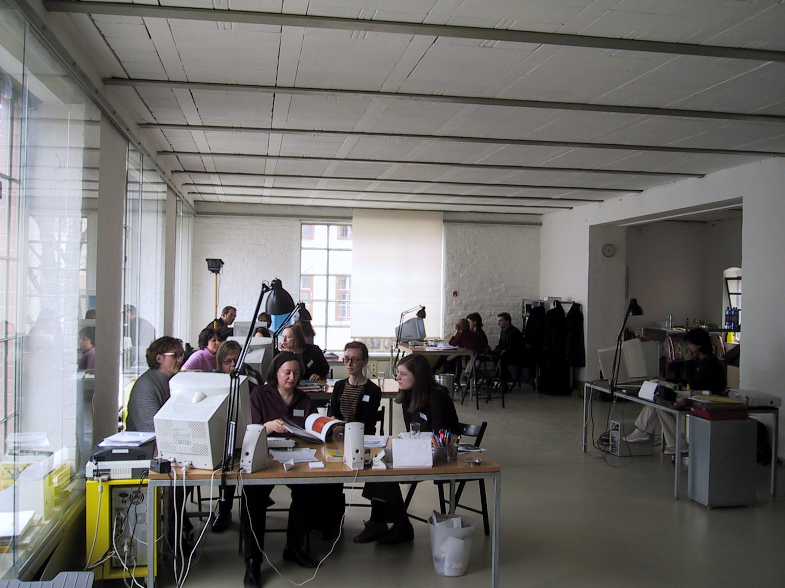
2014-2020
EVALUIERUNG
Prüfung der Förderfähigkeit, Ausschluss- & Auswahlkriterien
2) Vergabekriterien
Individuelle Evaluierung
Consensus Meetings
2. Consensus Meeting (mj. Projekte, Netzwerke, Plattformen)
Verhandlungen (mj. Projekte)
Evaluation Committee
Award Decision
Foto: © basis wien
Notes:
Literary Translation
In this area, the Culture sub-programme supports the translation and promotion of collections of fiction – known as packages – from one language to another.
All types of fiction can be translated, from a source into a target language both being official languages in countries taking part in the programme
The scheme also funds the promotion and distribution of these translated works through both traditional and digital channels, so they can reach new audiences.

Slide 32

2014-2020
SPECIAL ACTIONS
Europäische Kulturhauptstädte
Europäische Preise
EBBA – European Border Breakers Award
Europäischer Literaturpreis
Europäischer Architektur Preis
Europa Nostra Kulturerbe Preis
Europäisches Kulturerbesiegel
European Heritage Days
Notes:
About Creative Europe
So, what is the Creative Europe programme and why is it being launched? Well, The cultural and creative sectors express Europe’s immensely rich and diverse cultural heritage, and contribute to the development of our societies. These sectors play a major role in the European economy and help generate growth and jobs.
Creative Europe is designed to protect and promote cultural and linguistic diversity in the EU, strengthen the competitiveness of these sectors, and open up new markets, opportunities and audiences for those involved.
It brings together and builds on the success of the Culture, MEDIA and MEDIA Mundus programmes, which ran from 2007-2013, and offers thousands of artists, cultural professionals and organisations the chance to secure funding for a wide range of activities, within and outside the EU.
There are three parts to the new Creative Europe programme – the Culture sub-programme, the MEDIA sub-programme and the Cross Sectoral Strand – each of these will be covered in more detail later on in the presentation.

Slide 33

2014-2020
ANTRAGSTELLUNG
Registrierung Participants Portal
PIC: Participants Identification Code
Antragstellung online + Papier
Begleitbrief + USB Stick mit notwendigen Annexen
Siehe Checklist!
FOTOS: ©SHUTTERSTOCK
Notes:
Information
To find out more about the Creative Europe programme, visit the websites shown on the slide.

Slide 34
2014-2020
Danke für die
Aufmerksamkeit
elisabeth.pacher@bmukk.gv.at
Notes:
Distribution
These days, audiovisual professionals need to operate in both physical and online market-places.
To meet these demands, the MEDIA sub-programme offers support for international professional trade events, markets and other initiatives that can boost the circulation and distribution of European works inside and outside Europe, and international works in Europe.
However, it can be difficult to overcome the limitations the audiovisual industry faces in terms of film distribution outside domestic markets.
Financial help is available for European sales agents, theatrical distributors or exhibitors of European films to encourage and support the wider transnational distribution of recent European films in cinemas and on other platforms.

Slide 35
2014-2020
FOTOS
Best Practice Collection
Cultural Contact Point Austria
rotor>: Land of Human Rights © bankleer
Szene Salzburg: apap Rights © Wolfgang Kirchner
Ad libitum Konzertwerkstatt gGmbH, PurPur © ad libitum
ars electronica:© Finnbogi Petursson
Styriarte: © Werner Kmetitsch
MAK: © Andreas Krištof
Phonart, Logo: Igor Manasteriotti und Mia Maric
Weitere Bilder © SHUTTERSTOCK
Notes:
Transnational Cooperation
Under the Culture sub-programme, there are opportunities to lead or take part in a variety of transnational cooperation projects that involve cultural and creative organisations
These organisations must be from at least three countries taking part in the programme and the kinds of activities that are supported include:
The exchange of cultural workers, allowing them to gain the skills they need to meet the challenges of a changing environment.
Extended stays and residencies in other EU countries for artists and cultural professionals, allowing them to develop their careers internationally.
Co-productions and performances between cultural organisations from different countries, such as concert halls, theatres and orchestras, which extend the lifespan of a production and help it to reach new audiences.
Cross-border lending and borrowing of artworks, bringing them to citizens across Europe.

